Slide 1
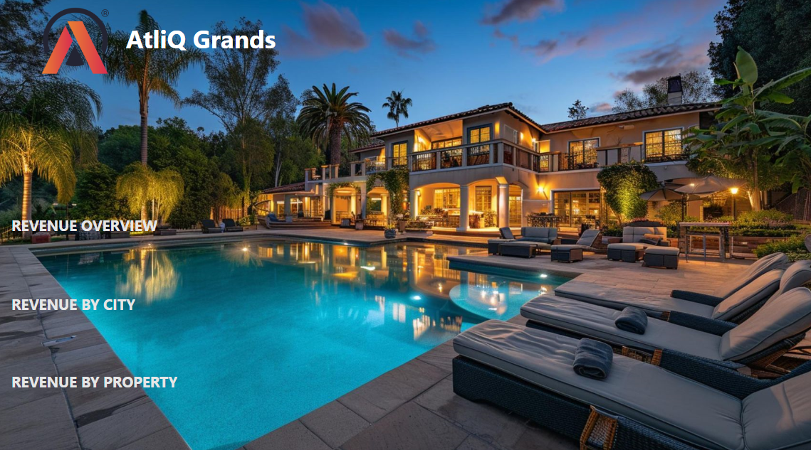

Slide 2




Problem Statement
AtliQ Grands owns multiple five-star hotels across India. They have been in the hospitality industry for the past 20 years. Due to strategic moves from other competitors and ineffective decision-making in management, AtliQ Grands are losing its market share and revenue in the luxury/business hotels category. As a strategic move, the managing director of AtliQ Grands wanted to incorporate “Business and Data Intelligence” to regain their market share and revenue.
They Want to provide them with insights from their historical data.

Slide 3
Primary Analysis
Occupancy % of Rooms by City.
Realization % by City.
Revenue Generated in each Location.
Bookings % by each Platform.
Bookings on day types like weekdays and weekends.
Occupancy % on day types.
Bookings % based on Room class.
Revenue Generated by each Property.
Average Ratings of the each Property.
Occupancy % and Average Ratings on weekly and monthly basis.

Slide 4
Secondary Analysis
Cancellation % of Rooms by Property.
Revenue by Category.
Total Bookings based on day type.
Realization % and ADR by Booking Platform.
Average Daily Rate(ADR).
Revenue Per Available Room(RevPAR).
Daily Sellable Room Nights (DSRN).
Daily Room Booking Nights(DRBN).
Daily Utilized Room Nights (DURN).

Slide 5


